Slide 1
Pixel Band
Clumsy Guppy Studios Present:
Diana Kumykova + Isabelle Cordova

Slide 2
Essential Features
With Pixel Band, the player is able to...
Compose simple tunes
Arrange a variety of different instruments
Experience visual feedback of what instruments are playing
Employ basic looping features to automate their composition

Slide 3
Orchestrate pixelated instruments into symphonic masterpieces
Logline

Slide 4
Activity Description
The Pixel Band toy concept is a response to overly-complicated composition programs such as Garage Band that aims to give its players a fun way to play around with different instrument sounds and create simple melodies by utilizing rudimentary looping features.

Slide 5
How Pixel Band Works
When the player initializes the toy, five instruments (violin, piano, guitar, bass, and drum) are displayed on the grid along with left and right arrows under each instrument and two large pause and play buttons at the bottom of the grid. When the user clicks on an instrument, the instrument loops a riff, and the user can click on the left and right arrow buttons below each instrument to cycle through the different sounds each instrument makes. The user is able to select as many or as few instruments as they want by simply clicking on an instrument to turn it on, and clicking on it again to turn it off. A green line will appear between the arrow buttons if an instrument is active, indicating to the user that the instrument is producing sound. The user has the ability to pause all instruments at once using the yellow pause button at the bottom of the grid, and can use the green play button to resume all active instrument sounds. If the user presses “M” on their keyboard they will activate the metronome which cycles through “1 2 3 4 5 6 7 8” on the status bar accompanied by dings on each beat. This feature can be disabled by pressing “M” again.

Slide 6
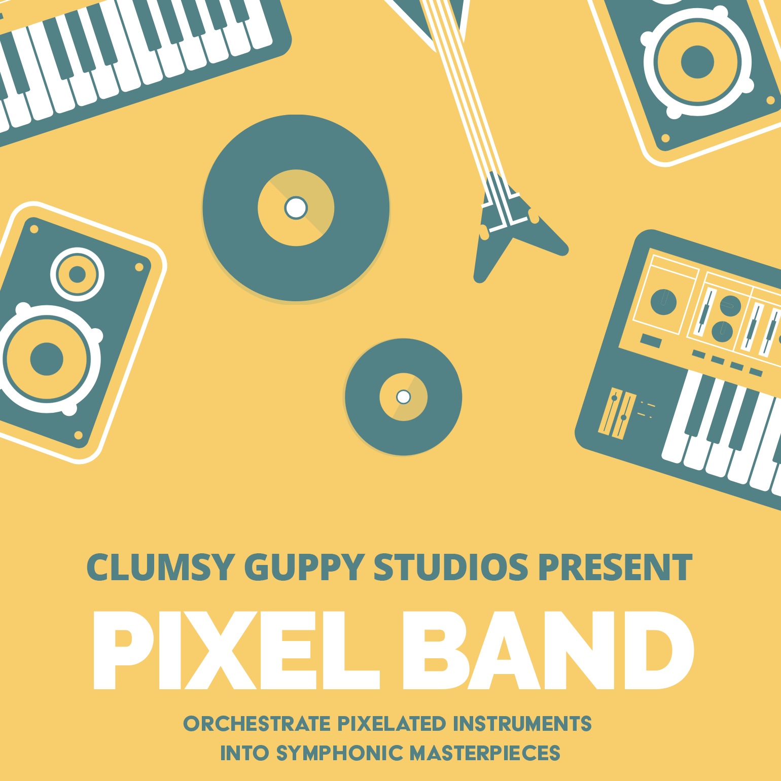
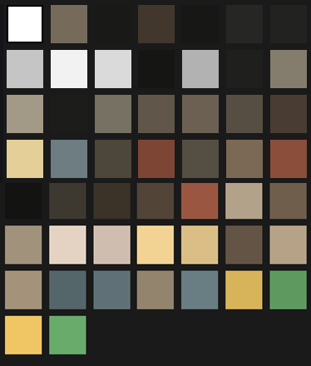
Toy Assets
Splash Image
Colors Used

Slide 7






Initial Instrument Ideation
Marimba
Piano
Trumpet
Bass
Drum

Slide 8
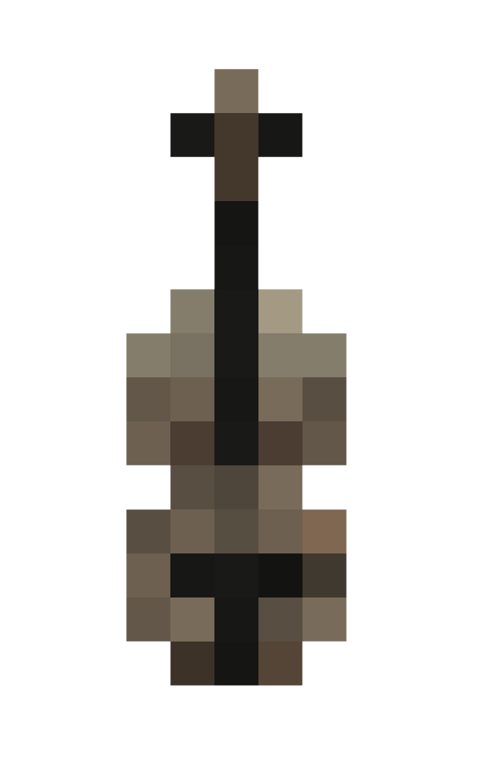

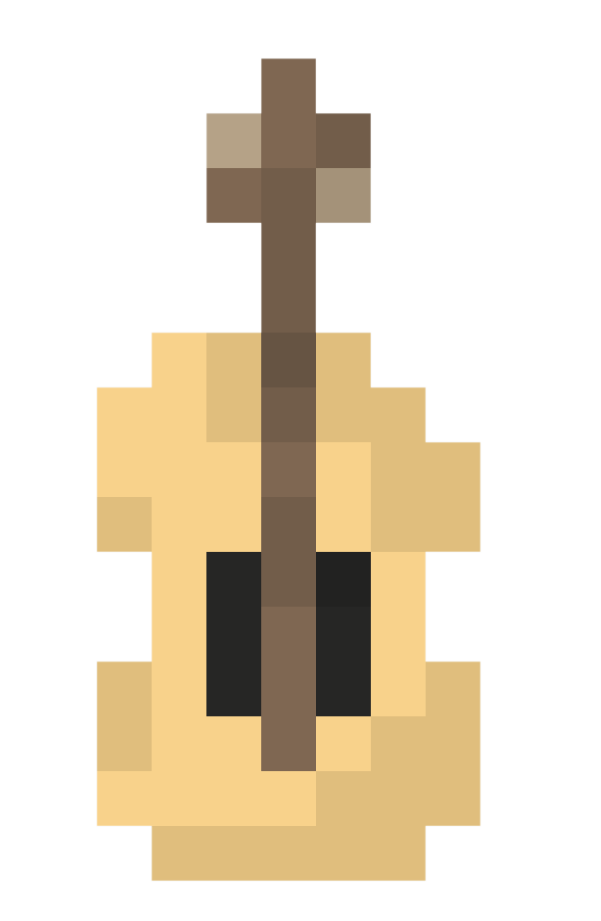
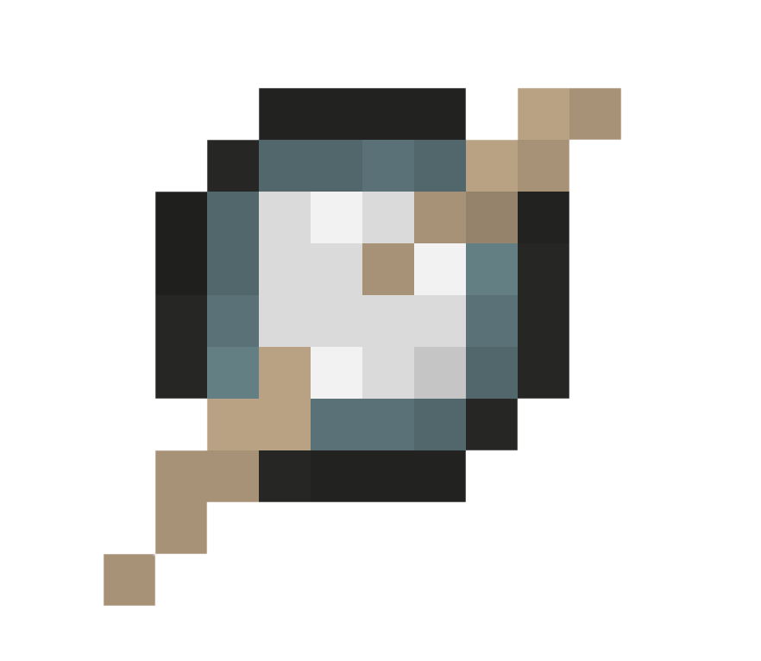
Final Instrument Assets
Violin
Piano
Guitar
Bass
Drum

Slide 9



Final User Interface
Bottom Controls
Instrument Sound Switchers
Pause/Play
Previous Sound
Next Sound

Slide 10
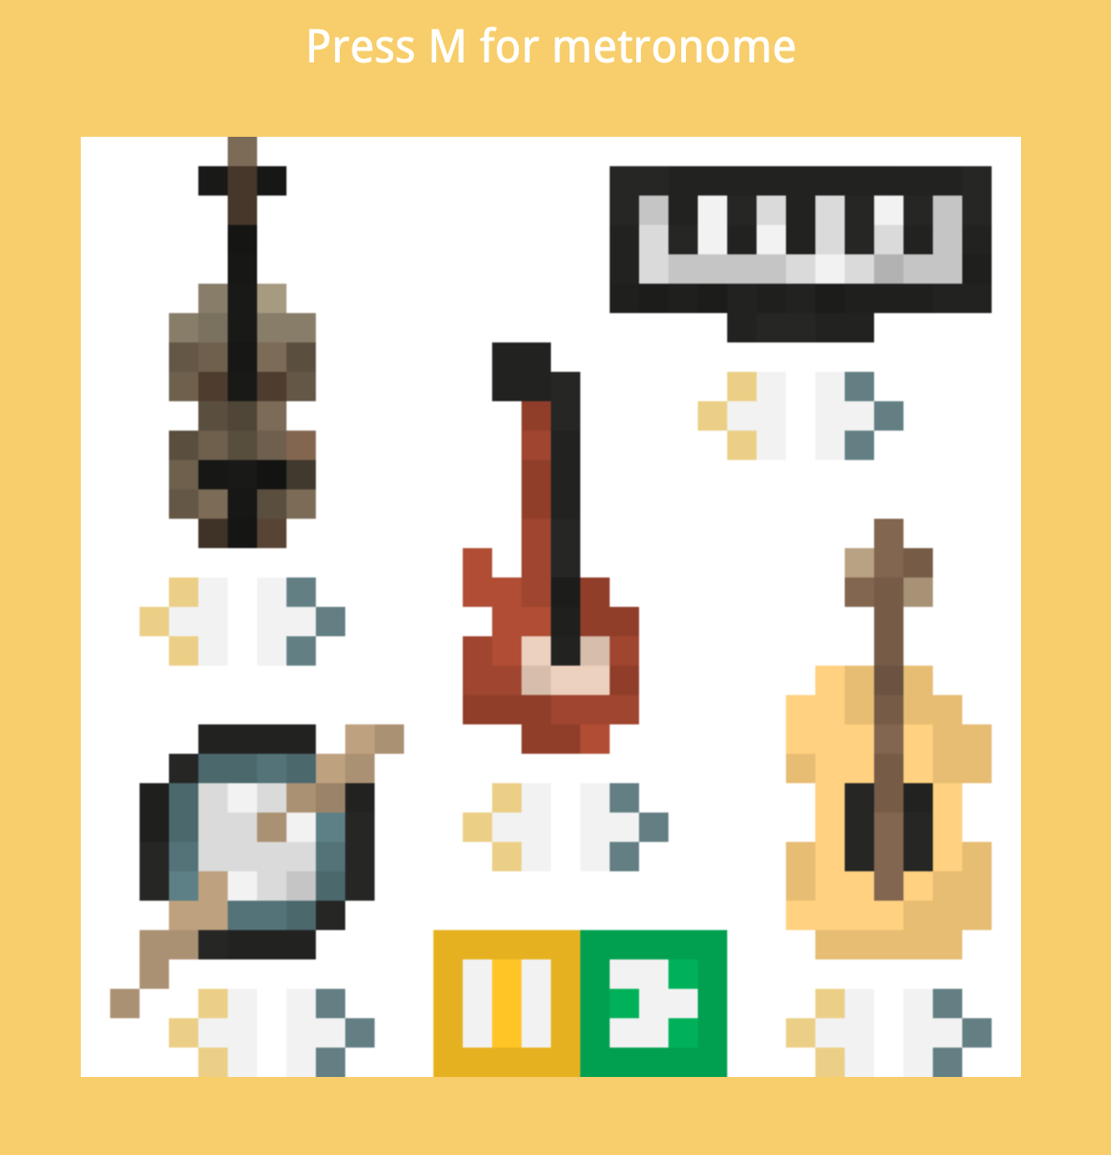
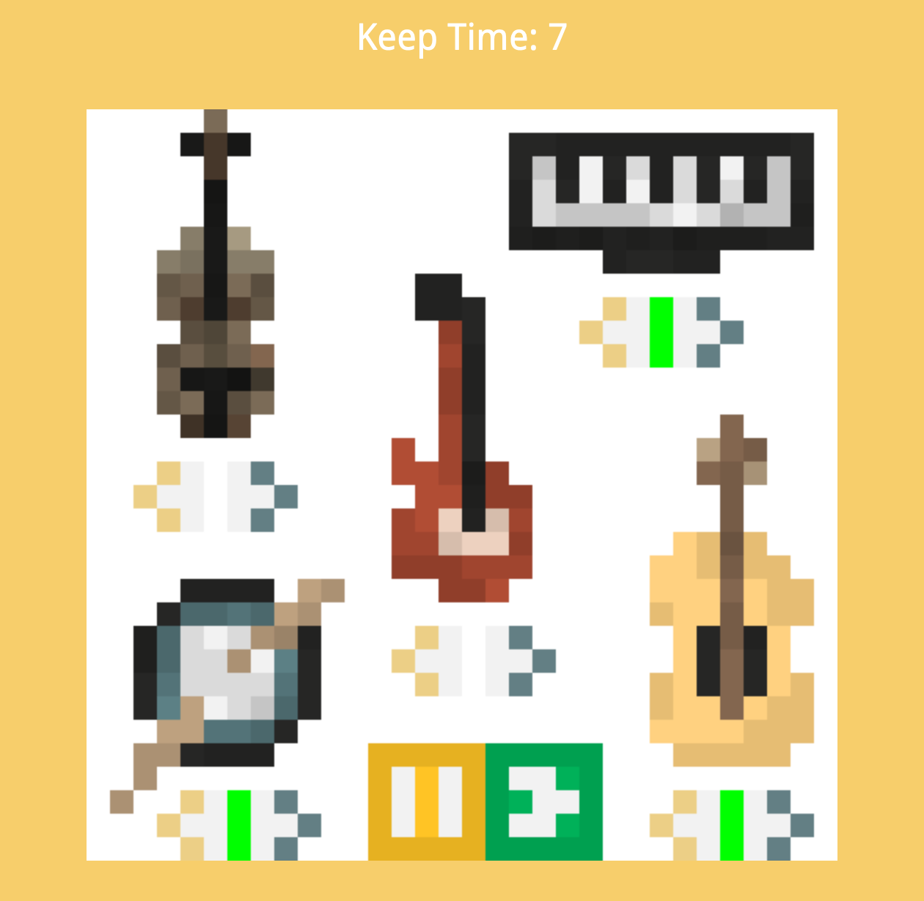
In-game View
On-Load Empty State
Multiple Instruments Active + Metronome

Slide 11
Sample Code
Access our JavaScript here:
https://github.com/ClumsyGuppy/ClumsyGuppy.github.io/blob/master/Website%20Files/A04/game.js

